Slide 1
Pre-requisites
Pre-Requisites :
To complete this project, you will need:
A code editor (such as Visual Studio Code, Sublime Text, or Atom)
A web browser
An internet connection
HTML, CSS or Bootstrap, and JavaScript knowledge

Slide 2
Project Flow
Project Flow :
To accomplish the objectives, we will complete the following activities:
Set up the project structure
Design and implement the user interface
Fetch data from the script file

Slide 3
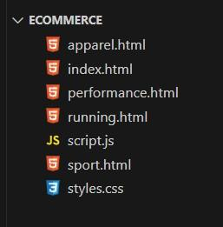
Project Structure
Project Structure :
The project structure will include the following files:
index.html: The main HTML file that contains the structure of the web page.
style.css: The CSS file that defines the styles for the user interface.
script.js: The JavaScript file that handles data and all functions that are used in projects and updates the UI.

Slide 4
Set up the project structure
Create a new project folder for the E commerce.
Inside the project folder, create the following files/folders:
index.html
style.css
script.js
running.html
apparel.html
performance.html
sport.html

Slide 5
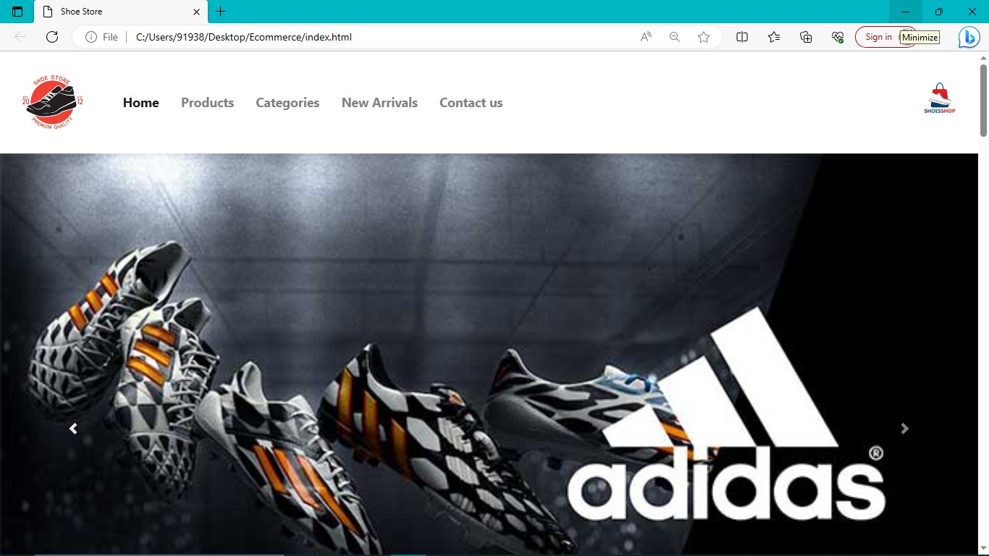

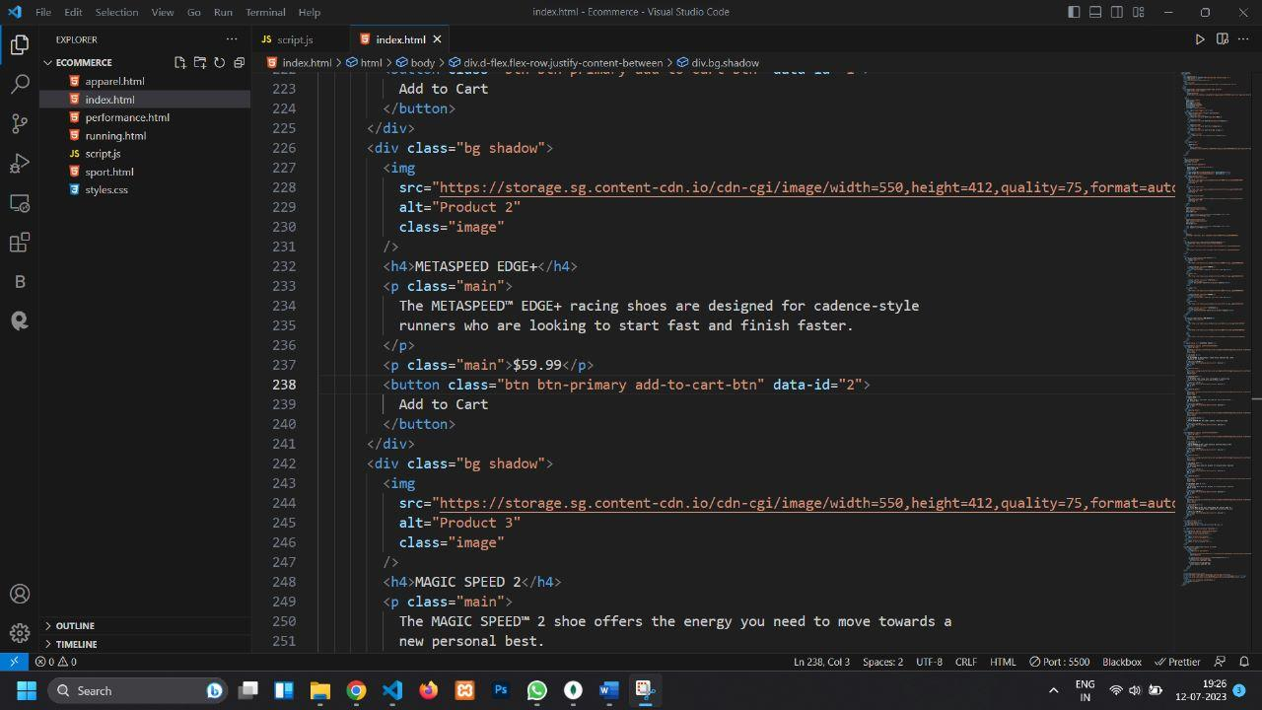
Design and implement the user interface :
Open index.html in your code editor.
Set up the basic HTML structure.
Design the layout and structure of the user interface using HTML elements and CSS classes.
Apply styles to the UI elements using CSS in style.css.
Link style.css to index.html.

Slide 6
Conclusion :
The E-commerce: Shoe Store is a web application that provides the user to watch various shoes according to the categories like running, best performance shoes, etc. It allow users to move their shoes to the cart and accordingly shows how much items are their in there cart and shows price as well.

